Slide 1

A201 Assignment 1
Review of the answers

Slide 2
Question 1
Bill, a computer science geek, has been hired by his brother's wife to watch over their 3 children (Mary aged 5, George aged 3, and Peter aged 1) while they go away on an overnight trip to Upper Sandusky. Mary only eats potatoes, peas and ham and she can watch 2 hours of television but should be put to bed at 8:45pm. She is not permitted to eat in front of the TV. George loves eating french fries and a hamburger while watching television with his sister. He should go to bed at 8:00PM.

Slide 3
Question 1 (cont’d)
Bill should wake him about 10:30 to send him to the bathroom so he does not wet his bed. Peter only eats canned baby food and just loves spinach and turkey. He normally eats at 5:00PM and after eating he will play for a half an hour then fall asleep for about 3 hours. Bill will need to change his diapers when he wakes up and after you clean him up, give him a bottle of formula. At about midnight, Bill will need to change his diapers.

Slide 4
Question 1 (cont’d)
Normally he will not wake up and will sleep soundly until 6AM when Bill will need to change him and given him a bottle of formula. George will wake up about 7:30 and want pancakes for breakfast. Bill should wake Mary up at 9:00 and she normally eats waffles. Bill wants to write an application that tracks the timing of all the tasks he has to do and be able to find out what he has to do next and list any task that is overdue. He also wants to be able to check on any one of the children and see what tasks he has completed and determine what he is supposed to do for the child next.

Slide 5
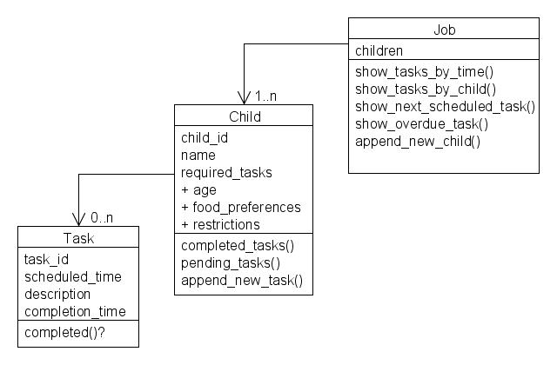
Q1 Class Decomposition
There is no inheritance
Extra attributes marked with (+) cover information mentioned but are not required for our applications

Slide 6
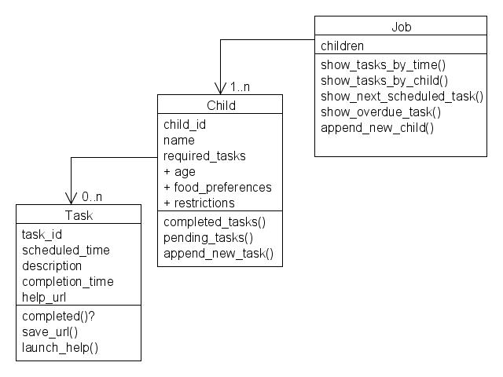
Extra credit
For extra credit, expand the model to allow Bill to store the URL of how-to sites on the Internet to help him with tasks he is unfamilar with (such as heating formula or changing diapers). He will need to have a way to activate the link within a web browser.

Slide 7
Question 2
You run a small bus company that provides transportation to guided tours. For each of these tours, your affliate company run by your sister provides the guide and a list of people to be picked up at their respective hotels. The tour has an itinerary of 8 places. There are often optional legs to the tour that individuals can elect to join while the remainder stay at their current location. Your responsibility is to provide transportation and to ensure that you do not loose any one in the process. You want to create an application that will allow you to track who joins the tour and the various optional segments. From this, you should be able to develop a list of who is on the bus at each stop of the tour. To make things easier for you, your sister has created a cool badge that all participants wear so that you can identify people by name or badge number. However, people change their minds often and you program needs to be able to enter and annotate last minute cancellations of tours or optional segments.

Slide 8
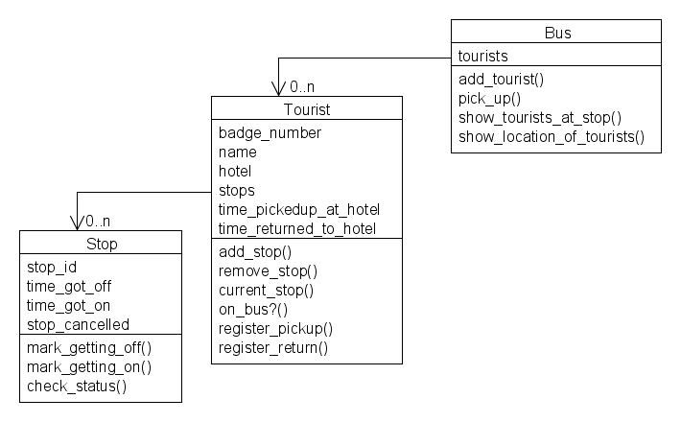
Q2 Decomposition

Slide 9
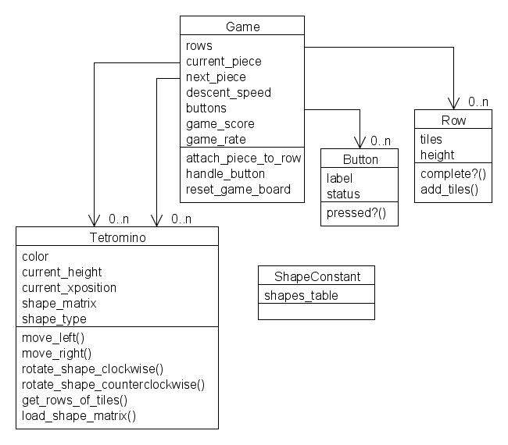
Question 3: Tetris

Slide 10
The End

